Slide 1
Finance(Fintech)
Digital Transformation
Ritesh Kumar
Jagadish Kavuturu
Srinivas Lakshman
Shalesh Nath Sharma

Slide 2
Agenda
Introduction: The need for digital transformation
Stages of Digital transformation
Assessment Criteria
Final Scoring Matrix
Solution Architecture
Digital Transformation Roadmap
Conclusion: The future of Fintech

Slide 3
Introduction - Global FinTech Corp (GFC)
Multinational financial services
Headquartered in London, UK
Operates in over 50 countries
Employs more than 100,000 people worldwide
Manages assets exceeding $2 trillion
Serves over 20 million customers globally.
GFC is looking forward to harness the power of data and emerging technologies to deliver innovative financial products and services that anticipate and meet its customers' needs.
GFC is looking forward to reimagine its internal processes and structures
GFC's strategic vision is to become a global leader in digital financial services
GFC, is exploring a range of transformation opportunities that could fundamentally enhance its operations and customer experience

Slide 4
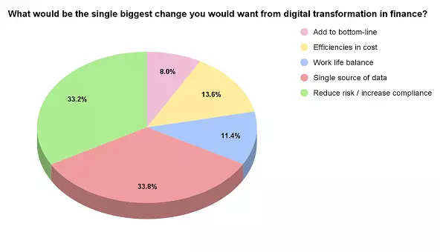
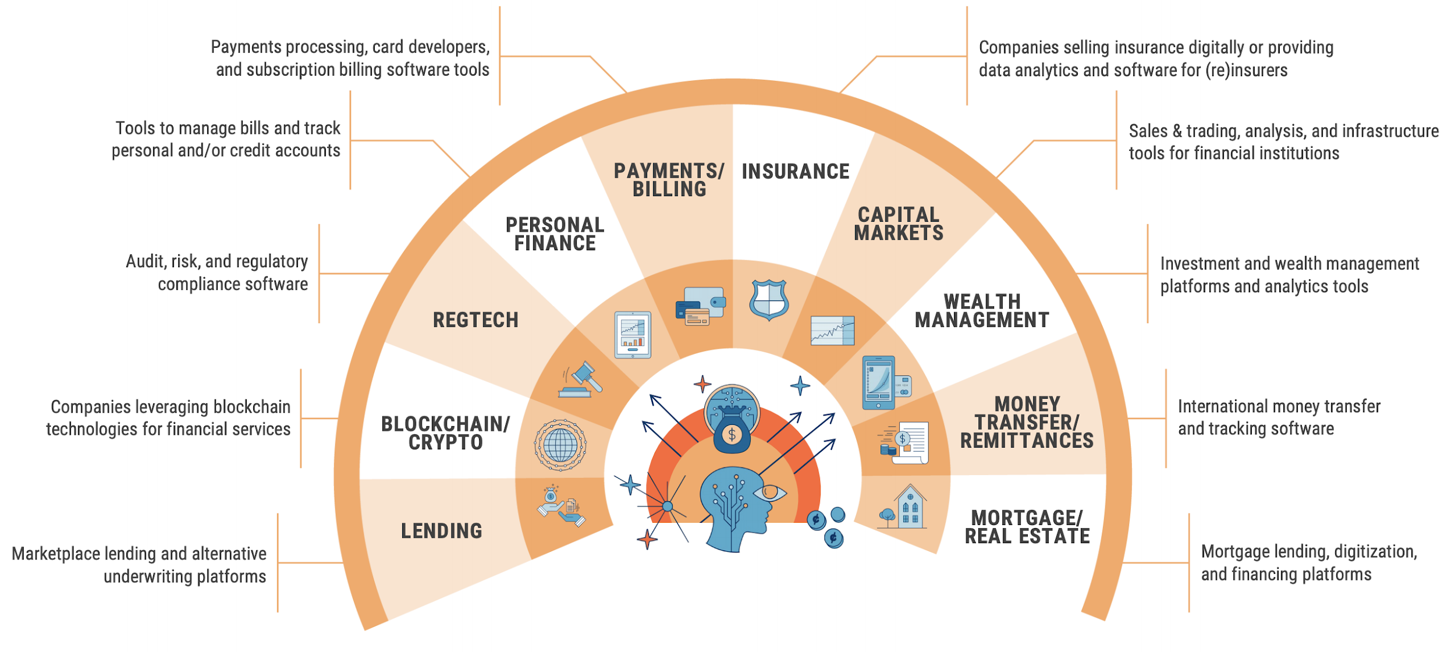

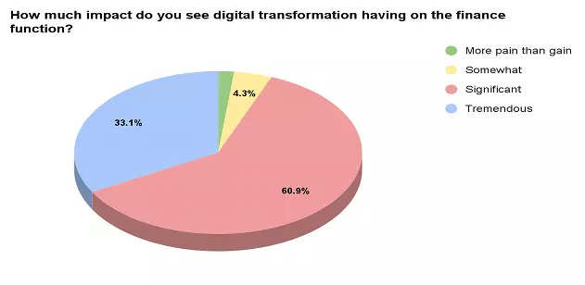
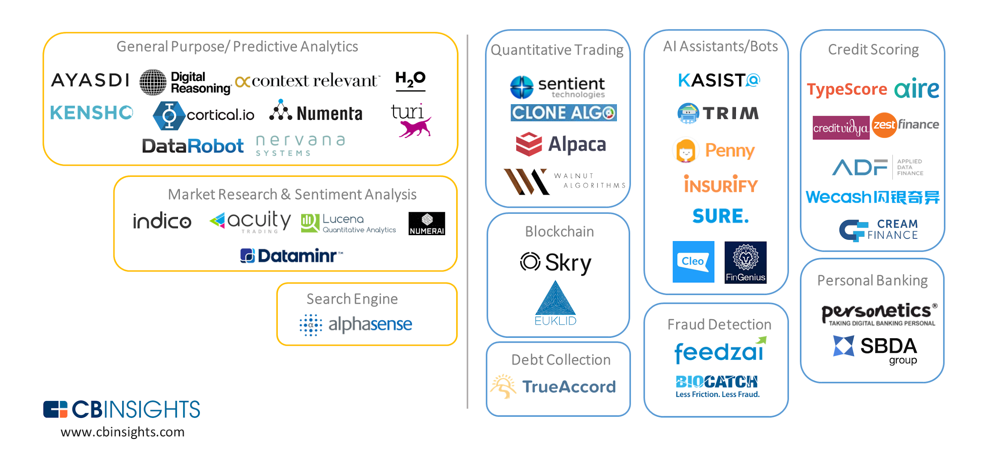
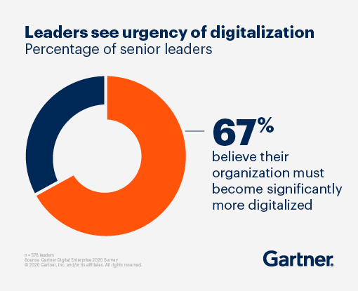
Need of Digital Transformation in Finance(Fintech)
Current challenges in finance:
Security and Fraud Prevention
Regulatory Compliance
Customer Acquisition and Retention
Technology Advancements
Service personalization
Financial technology (fintech) seeks to improve and automate the delivery and use of financial services.
Fintech Digital Transformation helps to streamline processes, increase efficiency, and provide real-time insights.
https://cfo.economictimes.indiatimes.com/news/digital-transformation-in-finance-34-cfos-want-a-single-source-of-data-says-clear-poll/97650833
https://www.gartner.com/en/finance/insights/finance-digitalization
https://www.smartdatacollective.com/ways-fintech-using-big-data-reshape-lending/
https://www.merixstudio.com/blog/fintech-app/

Slide 5

Stages of Digital Transformation
01
02
03
04
05
06
07
DATA GOVERNANCE, COMPLIANCE & ETHICS
ASSESS VIABILITY OF TRACKING OUTCOMES
ANALYTICAL APPROACHES TO SOLVE USE CASES
DIGITAL TRANSFORMATION ROADMAP
POTENTIAL IMPACTFUL
DIGITAL USE CASES
PRIORITIZATION OF USE CASES
ON DATA
EASE OF IMPLEMENTING
THE ARCHITECTURE
Identified 10 uses
cases in Finance
Ranking of use cases based on data inputs, availability, volume, frequency, and type
Recommendation of end state architecture from data sources, ingestion to preparation, analysis, publish and consumption
Evaluated use cases based on processes, policies, and standards ensuring integrity, availability, and accessibility.
Identified ways to generate insights by applying machine learning and data visualization techniques.
Readout of DT discovery to recommend roadmap across various milestones and proposed solution
Identified quantitative metrics, availability of tools and data to measure the outcome of ideas.
Notes:
The digital revolution in finance has ushered in a multitude of transformative use cases. After an exhaustive analysis, we identified the top 10 potential game-changers.
1. Prioritization of Use Cases on Data: The essence of any digital transformation hinges on data. By prioritizing the use cases based on data relevance and criticality, businesses can make informed decisions.
2. Ease of Implementing the Architecture: A seamless architecture implementation is vital. We've ranked use cases based on the simplicity of rolling out their respective digital architectures.
3. Recommendation of End-State Architecture: Our analysis offers a blueprint – from data sourcing and ingestion to preparation, examination, publishing, and finally, consumption. This ensures optimal data flow and utility.
4. Data Governance, Compliance & Ethics: Digital use cases were scrutinized against stringent benchmarks of processes, policies, and standards. This guarantees data's integrity, availability, and accessibility while upholding ethical standards.
5. Assess Viability of Tracking Outcomes: For effective digitization, tracking outcomes is crucial. We’ve assessed the feasibility of monitoring metrics and the tools required to gauge the results.
6. Analytical Approaches to Solve Use Cases: The spotlight is on leveraging machine learning and advanced data visualization techniques. These strategies unearth deep insights, driving the success of the identified use cases.
7. Digital Transformation Roadmap: A comprehensive readout from the digital transformation discovery phase is presented. This roadmap outlines milestones and proffers solutions, charting a clear course for digital integration in finance.
In summary, the Global Finance Corporation is ripe for digital disruption. By prioritizing data-centric use cases, adhering to governance standards, and leveraging cutting-edge analytical approaches, there is immense potential to redefine financial processes and deliver unparalleled value.

Slide 6
Assessment Criteria

Slide 7
CRITERIA 1: Short List Of Potentially Impactful Digital Use Cases
Use Case | Groups Benefitted | Cost-Reduction Impact | Satisfaction-related Impact | Profits Impacted | Aligned with Strategic Mission and Executive Support | Impact on Consumer Outcomes (Product / Service characteristics) | Volume of Individuals Impacted (from all the groups) | Impact to Society (Overall) | Average
Fraud Detection | 5 | 3 | 4 | 4 | 5 | 4 | 5 | 4 | 4.25
Digital and Personal Assistants / Chatbots | 5 | 4 | 4 | 3 | 5 | 4 | 5 | 3 | 4.125
Investment Predictions | 5 | 3 | 4 | 4 | 5 | 4 | 4 | 3 | 4
Automated Wealth Advisor (Wealth Bot) | 5 | 3 | 4 | 4 | 4 | 4 | 4 | 4 | 4
Portfolio Management | 5 | 3 | 4 | 4 | 4 | 4 | 4 | 3 | 3.875
Process Automation | 5 | 4 | 3 | 3 | 5 | 3 | 5 | 3 | 3.875
Credit Scoring | 4 | 3 | 4 | 4 | 4 | 4 | 3 | 4 | 3.75
Consumer Marketing and Cross-Selling | 4 | 3 | 4 | 4 | 4 | 4 | 4 | 3 | 3.75
High Frequency Trading and Algorithmic Trading | 4 | 3 | 4 | 4 | 4 | 4 | 3 | 3 | 3.625
Trade Settlements | 4 | 3 | 3 | 3 | 4 | 3 | 3 | 3 | 3.25
NLP for Customer Contracts | 4 | 3 | 3 | 3 | 4 | 2 | 3 | 2 | 3
Notes:
The Digital Transformation Roadmap for GFC brings a plethora of opportunities for improving efficiency, customer satisfaction, and the bottom line. Each transformation area offers unique advantages, with the most impactful being Fraud Detection, Digital Personal Assistants/Chatbots, and Investment Predictions.
Fraud Detection emerged as the highest scoring transformation area with an average score of 4.25. This transformation stands to benefit numerous groups, with potential for significant cost reduction, high alignment with GFC's strategic mission, and a notable societal impact. It also directly impacts the financial security of consumers and the reputation of the organization, thus making it a high-priority area.
Close behind is the implementation of Digital Personal Assistants and Chatbots, scoring an average of 4.125. The deployment of this technology not only benefits a broad range of groups but also reduces costs significantly, improves customer satisfaction, and is closely aligned with GFC's strategic mission. This transformation could have a large impact on the volume of individuals benefitting from instant, round-the-clock customer service.
Investment Predictions, with an average score of 4, offers significant benefits to various groups, enhances customer satisfaction, and potentially boosts profits. It aligns well with GFC's strategic mission and has a considerable impact on consumer outcomes, specifically in the realm of investment advisory services.
While all areas of transformation present promising opportunities for improvement, it is essential for GFC to prioritize them based on their strategic objectives, resource availability, and the urgency of customer and market demands. These digital initiatives could prove instrumental in maintaining GFC's competitive edge in the rapidly evolving FinTech landscape.

Slide 8
CRITERIA 2: Analytical Use Case Prioritization Based On Data Considerations
Use Case | Types of Input Data Needed | Is Success Measurement Possible with this data? | Data Availability | Volume of Data Needed | Frequency of Data Needed? | Are the data Structured or Unstructured? | Data Quality | Availability of match Keys and Business Knowledge around Data | Average
High Frequency Trading and Algorithmic Trading | 5 | 5 | 3 | 5 | 5 | 5 | 5 | 4 | 4.625
Fraud Detection | 5 | 5 | 4 | 5 | 5 | 4 | 5 | 4 | 4.625
Trade Settlements | 5 | 5 | 4 | 4 | 4 | 5 | 5 | 4 | 4.5
Investment Predictions | 5 | 5 | 4 | 5 | 4 | 4 | 5 | 4 | 4.5
Portfolio Management | 5 | 5 | 4 | 4 | 4 | 4 | 5 | 4 | 4.375
Digital and Personal Assistants / Chatbots | 5 | 5 | 4 | 4 | 5 | 3 | 4 | 5 | 4.375
Consumer Marketing and Cross-Selling | 5 | 5 | 4 | 4 | 4 | 4 | 5 | 4 | 4.375
Automated Wealth Advisor (Wealth Bot) | 5 | 5 | 4 | 4 | 4 | 4 | 5 | 4 | 4.375
Process Automation | 5 | 5 | 4 | 4 | 3 | 4 | 5 | 4 | 4.25
Credit Scoring | 5 | 4 | 4 | 4 | 4 | 5 | 4 | 4 | 4.25
NLP for Customer Contracts | 5 | 5 | 3 | 3 | 2 | 2 | 4 | 3 | 3.375
Notes:
High Frequency Trading and Algorithmic Trading and Fraud Detection stand at the top of the ranking with an average score of 4.625. The nature of these areas necessitates real-time, high-quality, and structured data, which is highly available in GFC. These transformation initiatives could potentially yield a high impact on the firm's trading capabilities and risk management while also driving significant value.
Next are Trade Settlements and Investment Predictions, both scoring an average of 4.5. These transformation opportunities align well with the strategic mission of the company and would impact a large volume of customers. Their success can also be directly measured, leading to noticeable improvements in operational efficiency and customer satisfaction.
Portfolio Management, Digital and Personal Assistants/Chatbots, Consumer Marketing and Cross-Selling, and Automated Wealth Advisor (Wealth Bot) follow closely with an average score of 4.375. These transformations would enhance the customer experience and broaden the firm's service offerings. With the high-quality data available, these initiatives are expected to have a significant impact on customer outcomes.
Process Automation and Credit Scoring come next with an average score of 4.25. The potential benefits from these transformations range from enhanced operational efficiency to expanded market segments, although the availability of all necessary data may vary.
Finally, NLP for Customer Contracts is at the bottom with an average score of 3.375. Despite the lower score, this transformation could still drive substantial value by streamlining contract management and reducing legal risks. The key challenge lies in handling the variety of unstructured data inherent in contracts, requiring a more specialized data management approach.
Overall, GFC's journey to digital transformation appears promising across the board, with several high-impact opportunities identified. The successful execution of these initiatives, however, would largely depend on the effective utilization and management of data.

Slide 9
CRITERIA 3: Ease Of Implementing Required Architecture
Use Case | Data Ingestion (Static / Streaming Data) | Volume of Data | Variety of data | Velocity of Data | Complexity of Data Processing | Overall Ease of Enterprise Architecture Implementation Score | Average
Fraud Detection | 4 | 5 | 3 | 5 | 4 | 3 | 4
Investment Predictions | 4 | 5 | 3 | 4 | 4 | 3 | 3.833
Portfolio Management | 4 | 4 | 3 | 4 | 3 | 3 | 3.5
Digital and Personal Assistants / Chatbots | 3 | 3 | 3 | 3 | 4 | 4 | 3.333
Consumer Marketing and Cross-Selling | 3 | 4 | 4 | 3 | 3 | 3 | 3.333
NLP for Customer Contracts | 2 | 3 | 5 | 2 | 5 | 3 | 3.333
Automated Wealth Advisor (Wealth Bot) | 3 | 3 | 3 | 3 | 3 | 4 | 3.167
Credit Scoring | 3 | 4 | 3 | 3 | 3 | 3 | 3.167
Trade Settlements | 3 | 3 | 2 | 3 | 3 | 3 | 2.833
Process Automation | 2 | 2 | 2 | 2 | 3 | 4 | 2.5
Notes:
Data ingestion, encompassing both static and streaming data, varies in terms of volume, variety, velocity, complexity of data processing, and ease of enterprise architecture implementation. For fraud detection, a considerable amount of data is ingested (scored 4 for volume), showing the highest variety (5) and complexity in data processing (5). This culminates in an average score of 4.000, making it the most complex use case in the list. Investment predictions follow closely with similar volumes and variety of data but slightly lower complexity (4) leading to an average score of 3.833. Meanwhile, trade settlements and process automation are at the simpler end of the spectrum, scoring 2.833 and 2.500 respectively, showing a lower data intensity and complexity.
Portfolio management deals with substantial volumes of data (4) and moderate variety (4), with a processing complexity also rated at 4. The average score for this use case stands at 3.500. Digital assistants and chatbots, consumer marketing, and NLP for customer contracts have comparable average scores of 3.333, highlighting the middle-tier complexity they offer. These systems handle different volumes and varieties, but their overall data processing challenges remain similar.
Lastly, automated wealth advisors (or "wealth bots") and credit scoring processes deal with moderate volumes, variety, and processing complexities, each achieving an average score of 3.167. This indicates a balanced data ingestion demand for these use cases, positioning them in the mid-range for overall complexity and architectural challenges.

Slide 10
CRITERIA 4: Data Governance, Compliance And Ethics
Use Case | Master Data Management | Reference Data Management | Metadata Management | Big Data Management | Data Quality Management | Data Architecture | Data Retention/ Archiving | Privacy/ Security | Ethical Data Management | Average Scores
Chatbots | 4 | 4 | 4 | 3 | 4 | 4 | 4 | 3 | 4 | 3.778
Process Automation | 4 | 4 | 4 | 3 | 4 | 4 | 3 | 4 | 4 | 3.778
Trade Settlements | 3 | 4 | 4 | 3 | 3 | 3 | 3 | 3 | 4 | 3.333
Investment Predictions | 3 | 4 | 3 | 3 | 3 | 3 | 3 | 4 | 3 | 3.222
Consumer Marketing and Cross-Selling | 3 | 4 | 4 | 3 | 3 | 3 | 3 | 2 | 3 | 3.111
Portfolio Management | 3 | 4 | 3 | 3 | 3 | 3 | 3 | 2 | 3 | 3
Wealth Bot | 3 | 4 | 3 | 3 | 3 | 3 | 3 | 2 | 3 | 3
Fraud Detection | 3 | 4 | 3 | 2 | 3 | 3 | 3 | 2 | 3 | 2.889
Credit Scoring | 3 | 4 | 3 | 3 | 3 | 3 | 3 | 2 | 2 | 2.889
HFT and Algorithmic Trading | 2 | 4 | 3 | 2 | 2 | 2 | 3 | 4 | 3 | 2.778
NLP for Customer Contracts | 2 | 3 | 3 | 2 | 3 | 2 | 2 | 2 | 3 | 2.444
Notes:
In the context of Global FinTech Corp. exploration into various use cases for AI in the financial services industry, the evaluation of each use case's data management complexity has been considered across several dimensions, including Master Data Management, Reference Data Management, Metadata Management, Big Data Management, Data Quality Management, Data Architecture, Data Retention/Archiving, Privacy/Security, and Ethical Data Management.
The use cases of Digital Personal Assistants/Chatbots and Process Automation rank highest in terms of ease of data management, each with an average score of 3.778 out of 5. These areas involve a significant amount of customer interaction data and straightforward reference data, making it easier to manage. However, the high volume of data in these cases could pose challenges in Big Data Management.
Trade Settlements and Investment Predictions follow with average scores of 3.333 and 3.222, respectively. For these, the diversity of data sources and the need for real-time data processing are factors that contribute to their complexity.
Consumer Marketing and Cross-Selling, Portfolio Management, and Automated Wealth Advisor (Wealth Bot) have similar scores, reflecting the balance between the complexities of handling diverse data sources and the benefits of relatively straightforward reference data.
Fraud Detection and Credit Scoring score lower, at 2.889, due to the critical need for high data quality, data privacy, and security, coupled with the complex data architecture necessary for real-time processing.
In summary, while all these use cases present unique opportunities for AI transformation in the financial services industry, they also pose varying levels of challenges in data governance and data compliance considerations.

Slide 11
CRITERIA 5: Objectives And Assessing Viability Of Tracking Outcomes
Use Case | What does success look like for a solution addressing this problem? | How can this success be measured (both to determine a baseline and then ongoing progress against that) from the data? What KPIs will be tracked? | Overall Ease of Measurement
Digital Personal Assistants and Chatbots | Quicker response times for customer service, a reduction in the volume of basic inquiries managed by human operators, and an enhancement in customer satisfaction. | A reduction in the average time taken to respond, a rise in the proportion of inquiries that chatbots handle independently without requiring human assistance, and enhanced scores for customer satisfaction. | 5 (Key Performance Indicators can be conveniently evaluated using system-generated reports and customer feedback surveys)
Investment Predictions | Improved precision in forecasting investments and a notable rise in customer satisfaction. | Enhancement in Return on Investment and a marked improvement in customer satisfaction levels. | 5 (Key Performance Indicators can be conveniently evaluated using system-generated reports and customer feedback surveys)
Process Automation | A significant decrease in operational expenses coupled with a marked enhancement in process accuracy. | The reduction in operational expenses can be straightforwardly quantified. Similarly, precision metrics are a fundamental part of reporting and can be tracked easily. | 5 (Key Performance Indicators can be conveniently evaluated using system-generated reports and customer feedback surveys)
Credit Scoring | Improved precision in predicting creditworthiness and a rise in customer numbers attributable to enhanced credit risk assessment. | The precision of the predictive model and the extra business acquired as a result. | 4 (While it's straightforward to quantify the accuracy of credit scores and the additional business garnered from new customers, attributing the degree of success directly to the AI/ML model can pose a challenge.)
Consumer Marketing and Cross-Selling | Enhancement in rates of customer acquisition and customer retention. | Monitoring the rates of customer acquisition and customer retention. | 4 (Attributing the extent of customer satisfaction and retention rates to the AI/ML model can be challenging).
Trade Settlements | Decreased timeframes for settlement, diminished number of trade disagreements and mistakes, and enhanced satisfaction among customers. | Decrease in the duration of trade settlements, reduction in trade disputes and errors, and enhanced customer satisfaction levels. | 4(Attributing the extent of KPIs' performance to AI/ML model can be challenging.
Fraud Detection | A decrease in the occurrence of fraudulent transactions, and an increased identification of potential threats. | The count of identified fraudulent transactions, the precision rate of the fraud detection system, and the tally of potential threats spotted. | 3 (Measurement of undetected fraudulent activities is feasible but may be delayed, and the potential threats might remain unnoticed for an extended period.)
NLP for Customer Contracts | Decrease in the current time and resources allocated towards managing contracts. | Decrease in both the resources and time devoted to contract management, as well as a reduction in the frequency of contract disputes. | 3 (While direct metrics such as resources and time utilized in contract management, and the count of contract disputes, are straightforward to measure, assessing a reduction in legal risk and ensuring compliance introduces a layer of complexity.)
Portfolio Management | Boost in client satisfaction, enhancement in the performance of portfolios, and an increase in the Assets Under Management (AUM). | Customer Satisfaction Scores, Return on Investment, Assets Under Management | 3 (Metrics such as Customer Satisfaction and Assets Under Management can be measured directly, but gauging the genuine influence of advancements in portfolio management could be intricate.)
High Frequency Trading and Algorithmic Trading | Enhancement in the volume of trades and an escalation in profitability. | Monitoring of trade frequency and revenue generated. | 3 (While trade volumes and profits can be straightforward to track, delineating the specific influence of the AI model on these factors might pose challenges)
Automated Wealth Advisor (Wealth Bot) | Growth in the number of customers, enhancement in customer satisfaction ratings, and an upsurge in the Assets Under Management. | Monitoring the count of customers utilizing the service, gauging customer satisfaction indices, and tallying the Assets Under Management. | 3 (Linking growth in Assets Under Management directly to the application of the wealth bot can pose certain challenges)
Notes:
Implementing artificial intelligence (AI) technologies in various operations and services in the financial industry can bring forth transformational changes. However, gauging the impact and success of such initiatives requires meticulous measurement and monitoring of predefined Key Performance Indicators (KPIs). The ease of this measurement varies depending on the particular AI use case.
For use cases like Digital Personal Assistants and Chatbots, Investment Predictions, and Process Automation, the ease of measurement is relatively high, scoring 5/5. This is predominantly due to the direct nature of their KPIs which can be straightforwardly derived from system reports and customer surveys. For instance, a chatbot’s effectiveness can be quickly gauged by the reduction in response time, the percentage of inquiries handled, and improvements in customer satisfaction scores. Similar principles apply to Investment Predictions and Process Automation where their success is linked to observable and measurable metrics.
On the other hand, Credit Scoring and Consumer Marketing and Cross-Selling have a slightly lower ease of measurement score of 4/5. In these cases, improvements can be observed and quantified, but attributing the extent of these improvements to the AI/ML model specifically can be challenging due to the presence of other influencing factors.
Further down the scale, we find Fraud Detection, NLP for Customer Contracts,
Despite the variance in ease of measurement across different use cases, it is important for organizations to not shy away from leveraging AI due to measurement challenges. Instead, the focus should be on developing robust, multi-faceted, and adaptable measurement frameworks. These frameworks should be capable of accurately capturing the holistic impact of AI implementations, thereby helping organizations to continually optimize their AI strategies and maximize their return on investment. Through this approach, the financial industry can harness the full potential of AI to drive innovation, efficiency, and growth.

Slide 12
CRITERIA 6: Appropriate Analytic Approaches To Solving Business Problems
Use Case | What business question are you trying to answer with data visualization and modelling? | What kind of data visualization would provide useful insights? | What kind of machine learning, forecasting or analytics is suggested? | What algorithmic approach do you expect to lead with to solve this? | Overall Ease of Data Analysis and Modelling Score
Digital Personal Assistants/ Chatbots | How can we optimize customer service interactions and enhance sales through chatbots? | Visualization of chatbot interactions: volume, resolution rate, customer satisfaction, and product recommendations' success rate. | Supervised learning for intent recognition, reinforcement learning for optimizing chatbot responses. | Deep learning models for NLP, especially RNNs or Transformers for understanding customer intents. | 4
Fraud Detection | How can we proactively identify and prevent fraudulent transactions? | Heatmaps showing locations of detected fraud, time series of fraud occurrence, and feature importance plots. | Anomaly detection and supervised classification. | Ensemble methods like Random Forests and Gradient Boosting Machines, neural networks for deep pattern recognition. | 3
Credit Scoring | How can we predict the likelihood of a customer defaulting on a loan or credit? | Feature correlation matrices, ROC curves, and precision-recall curves. | Supervised classification. | Logistic regression, decision trees, and support vector machines. | 2
NLP for Customer Contracts | How can we automate contract analysis and identify potential risks? | Word clouds for frequently occurring terms, bar graphs for anomalies detected. | Text classification and clustering. | Transformer models like BERT for deep text understanding and extraction. | 4
Portfolio Management | How can we optimize portfolio returns for varied risk profiles? | Portfolio risk-return scatter plots, time series of portfolio performance. | Regression analysis and time-series forecasting. | Linear regression for predicting returns, Markowitz's Efficient Frontier for optimization. | 3
High Frequency Algorithmic Trading | How can we maximize profits through algorithmic trade strategies? | Time series for stock price movements, volume heatmaps. | Time-series analysis and forecasting. | ARIMA, GARCH for volatility prediction, and reinforcement learning for trade strategy optimization. | 4
Investment Predictions | How can we predict future investment opportunities based on current data? | Trend lines, candlestick charts, sentiment score histograms. | Time-series forecasting and sentiment analysis. | LSTM networks for time series, Naive Bayes or RNN for sentiment analysis. | 3
Process Automation | How can we identify inefficiencies in current processes? | Process flow diagrams, Gantt charts, and heatmaps of bottlenecks. | Pattern recognition and clustering. | Decision trees to map processes, clustering algorithms like K-means for identifying inefficiencies. | 2
Consumer Marketing and Cross-Selling | How can we predict which product a customer is likely to purchase next? | Customer journey maps, product correlation matrices. | Collaborative filtering and classification. | Matrix factorization for recommendation systems, decision trees or neural networks for product prediction. | 3
Trade Settlements | How can we optimize the trade settlement process for efficiency and security? | Transaction timelines, bar graphs for settlement delays. | Process automation and anomaly detection. | RPA for automation, isolation forests or one-class SVM for anomaly detection. | 2
Automated Wealth Advisor (Wealth Bot) | How can we provide personalized investment advice automatically? | Customer financial health dashboards, pie charts of portfolio distribution. | Regression, classification, clustering. | Decision trees for rule-based advice, clustering for customer segmentation, and regression for predicting investment outcomes. | 3
Notes:
In the evolving landscape of data-driven decision-making, various use cases emphasize the critical role of data visualization and modelling in answering pertinent business questions. The challenge of optimizing customer service interactions and bolstering sales via Digital Personal Assistants and Chatbots presents a complexity score of 4, indicating the sophisticated nature of the data analysis required. Similarly, with a score of 4, the automation of contract analysis through Natural Language Processing (NLP) for Customer Contracts, and the quest to maximize profits in High-Frequency Algorithmic Trading, indicate the intricacies involved in these areas.
The proactive identification and prevention of fraudulent activities under Fraud Detection have a complexity score of 3, mirroring the continual evolution of fraud patterns and the persistent need for real-time data analysis. This score is also reflected in the challenges of optimizing Portfolio Management to cater to various risk profiles, forecasting Investment Predictions based on current data, discerning the next potential product a consumer might buy in Consumer Marketing and Cross-Selling, and devising an Automated Wealth Advisor or "Wealth Bot" that can dispense personalized investment advice.
Credit Scoring, with its focus on predicting the likelihood of a customer defaulting on credit, fetches a score of 2. This signifies the availability of established methodologies, albeit their efficiency being contingent on data quality. Likewise, the task of pinpointing inefficiencies in existing processes under Process Automation and the ambition to streamline and secure the Trade Settlements process are both marked with a score of 2. These scores underline the structured nature of the processes in question, although they often demand a thorough domain understanding. Across these use cases, the essence remains consistent: harnessing the power of data to make informed, strategic decisions.

Slide 13
Final Scoring Matrix

Slide 14
FINAL RANKING OF USE CASES
USE CASES | Potential Impactful Use Cases | Data Source Assessment Ratings | Enterprise architecture assessment | Data Governance and Compliance | Overall Ease of Measurement of Project Outcomes | Overall Ease of Data Analysis and Modelling | Average
Digital and Personal Assistants / Chatbots | 4.13 | 4.38 | 3.33 | 3.78 | 5.00 | 4.00 | 4.10
Investment Predictions | 4.00 | 4.50 | 3.83 | 3.22 | 5.00 | 3.00 | 3.93
High Frequency Trading and Algorithmic Trading | 3.63 | 4.63 | 4.33 | 2.78 | 3.00 | 4.00 | 3.73
Fraud Detection | 4.25 | 4.63 | 4.00 | 2.89 | 3.00 | 3.00 | 3.63
Consumer Marketing and CrossSelling | 3.75 | 4.38 | 3.33 | 3.11 | 4.00 | 3.00 | 3.59
Process Automation | 3.88 | 4.25 | 2.50 | 3.78 | 5.00 | 2.00 | 3.57
Portfolio Management | 3.88 | 4.38 | 3.50 | 3.00 | 3.00 | 3.00 | 3.46
Automated Wealth Advisor (Wealth Bot) | 4.00 | 4.38 | 3.17 | 3.00 | 3.00 | 3.00 | 3.42
Credit Scoring | 3.75 | 4.25 | 3.17 | 2.89 | 4.00 | 2.00 | 3.34
Trade Settlements | 3.25 | 4.50 | 2.83 | 3.33 | 4.00 | 2.00 | 3.32
NLP for Customer Contracts | 3.00 | 3.38 | 3.33 | 2.44 | 3.00 | 4.00 | 3.19

Slide 15
Solution Architecture

Slide 16
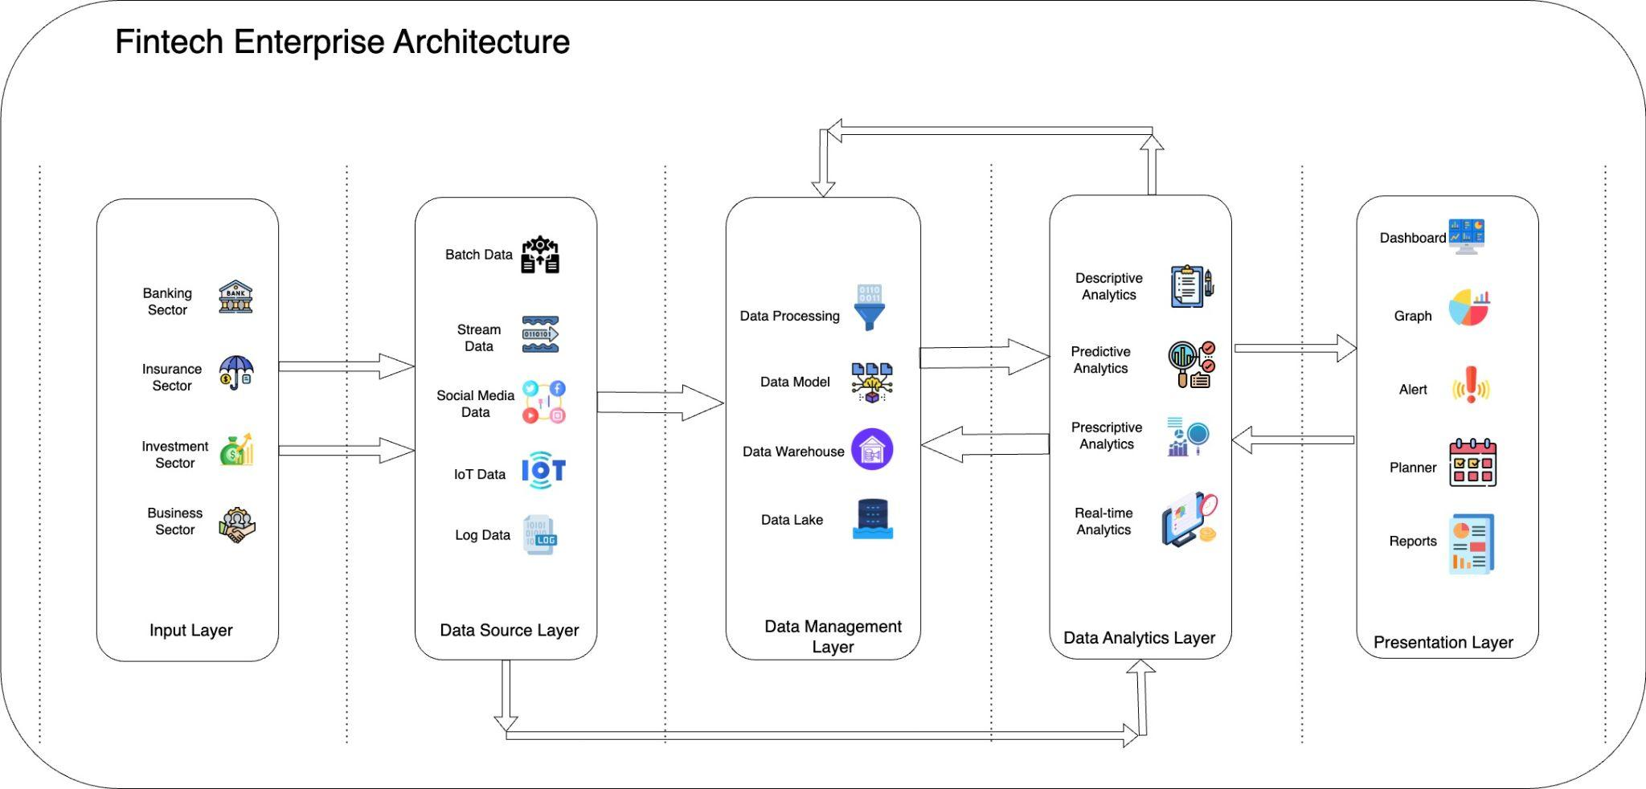
Solution Architecture
Digital Transformation Metrics:
1. ROI on digital transformation
2. Time to market
3. Usage KPIs
4. Productivity KPIs
5. Adoption & Performance Metrics
6. Percentage of Cloud Deployments
Solution Architecture

Slide 17
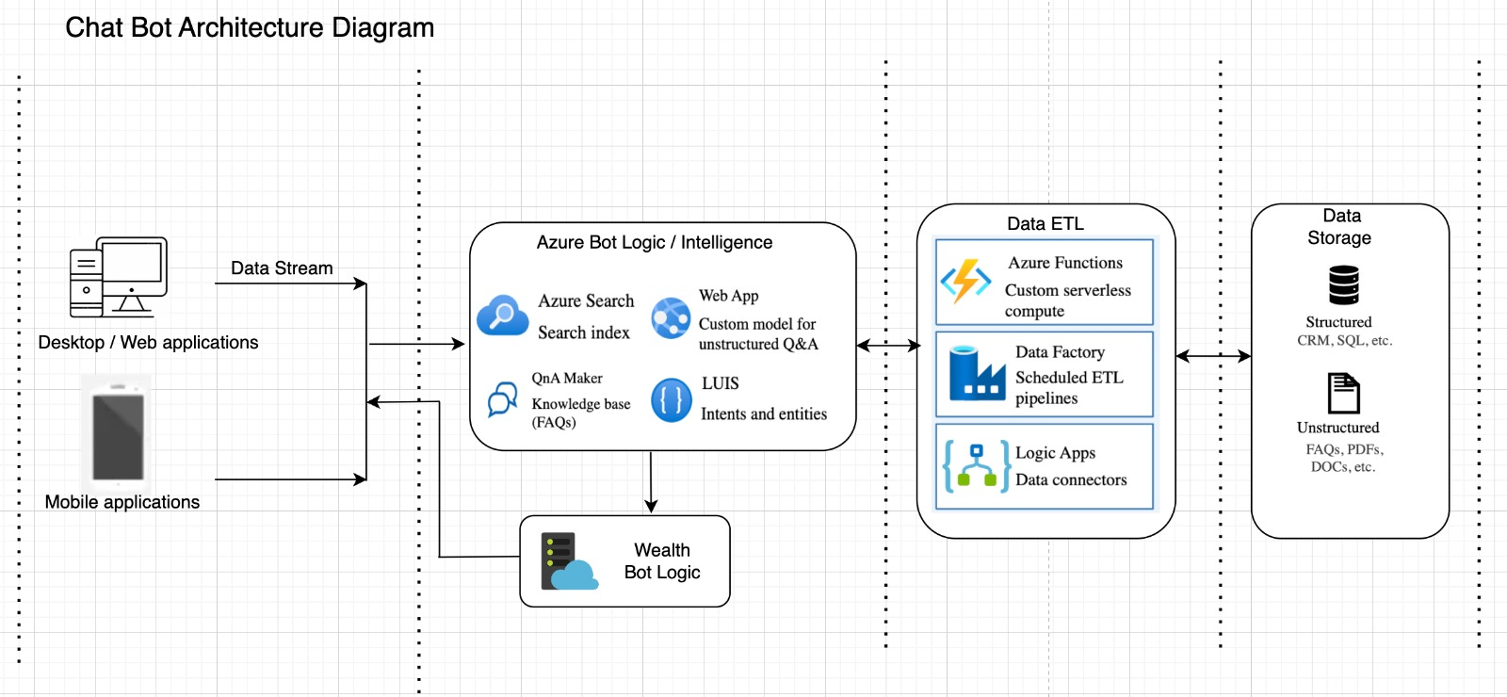

Slide 18
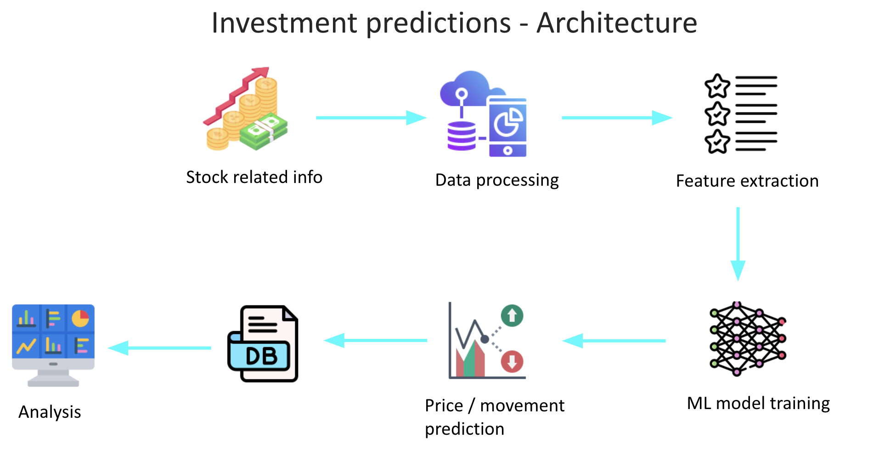

Slide 19
Digital Transformation Roadmap

Slide 20
Change Management
1
2
3
4
5
Prepare the Organization for Change
Craft a Vision and
Plan for Change
Implement the Changes
Embed Changes Within Company Culture and Practices
Review Progress and Analyze Results
Changes to the company’s structure, strategy, systems, processes, employee behaviours, or other aspects
Prepared both logistically and culturally
Strategic goals
Key performance indicators
Project stakeholders and team
Project scope
Conducting analysis and review, or a “project post mortem
Change managers must prevent a reversion to the prior state or status quo
Organizational change refers broadly to the actions a business takes to change or adjust a significant component of its organization. This may include company culture, internal processes, underlying technology or infrastructure, corporate hierarchy, or another critical aspect.
Adaptive changes are small, gradual, iterative changes that an organization undertakes to evolve its products, processes, workflows, and strategies over time.
Transformational changes are larger in scale and scope and often signify a dramatic and, occasionally sudden, departure from the status quo.
https://online.hbs.edu/blog/post/change-management-process

Slide 21
The five-stage digital transformation model
5
4
Living DNA
3
Perpetual loving culture of constant digital reinvention as the backbone of the business model
Fully Synchronized
2
Completed digital transforms, products or processes for digital transformations
Partially Synchronized
1
Coordinated programs for strategic transformation across the enterprise
Siloed
Foundation
Siloed or departmental programs for transformation
Program to digitally automate processes in the organization

Slide 22
Chatbots : Roadmap
Identify and Strategize | Design and Develop | Optimize and Improve | Sustain
2 months | 2 months | 1 month | 1 month
People and Process | Hire the right Digital Transformation Team | Collaboration b/w Stakeholders and DT team Process Automation Standardize taxonomy for data classification Focus on customer satisfaction | Data Collection Continuous Monitoring Iterative Refinement. Employees can focus on complex queries. Customer satisfaction scores No-Low human intervention | End user training Increased team collaboration User adoption and acceptance Customer retention Post-interaction surveys – high scores
Data capture and integration | Identify data sources Data Acquisition Strategy static and real time data. Customer queries, responses, and historical chat log | Structured queries Customer, Transaction, Product, and Services data | Relevance based assisted classification Schema updates | Gather feedback and refine AI tools learn from interactions Tackle more complex questions Chatbots with product recommendation Personalized up-selling and cross-selling
Technology and platform | Digital Maturity Assessment Identify potential technologies. | Supervised Learning for Intent Recognition. Reinforcement Learning for Response Optimization Deep Learning Models for NLP Transformers. Transfer Learning. | Custom development as per any scope revisions Product recommendation systems | Uptime and high availability Scalability

Slide 23
Investment predictions : Roadmap
Identify and Strategize | Design and Develop | Optimize and Improve | Sustain
1 month | 2 months | 1 month | 2 months
People and Process | Assess workforce skills Identify the process that will be impacted | Automated predictions Back-testing methodologies. | Data Quality External Factors Continuous Learning Diversification Improved accuracy on Automated predictions | Forecasts based on historical data and market trends Higher customer satisfaction
Data capture and integration | Data Sources: APIs like Quandl, Alpha Vantage or EOD Historical transaction data, Streaming market data, and customer profile data | Quantitative information that could identify trading signals and capture the movement patterns of the stock market | Complex data like real-time news, social media sentiment | Improvise based on model outcomes
Technology and platform | Deep learning libraries like Tensorflow or PyTorch Timeseries databases such as InfluxDB or TimescaleDB Data warehouses like Google BigQuery or AWS Redshift Tableau dashboards. | Time-Series Forecasting Sentiment Analysis Feature Importance Analysis Requires sophisticated ML models, simulations | Anomaly Detection LSTM (Long Short-Term Memory) Networks Naive Bayes RNN (Recurrent Neural Networks) Decision Trees or Random Forests | Monitor and maintain the system Observe low latency

Slide 24
Conclusion: The Future of Fintech
The fintech will undergo a revolution thanks to Digital transformation, becoming more inventive and customer-focused.
Initiatives in digital finance will provide Subject Matter Experts (SMEs) with more individualised experiences, improved operational efficiency, and loan flexibility.
Mobile banking, AI and ML, blockchain, open banking, and customer-centric digitisation are some of the next developments in fintech.
Faster decision-making, better loan evaluations, and greater operational effectiveness are all made possible by automation.
Technology adoption and data privacy are two risks and problems that come with the transformation, but overall, the advantages exceed them by a wide margin. Companies can effectively navigate these difficulties and enjoy the benefits of a future transformed by digital technology with the correct implementation strategy and change management tactics.

Slide 25
THANK YOU

